Slide 1

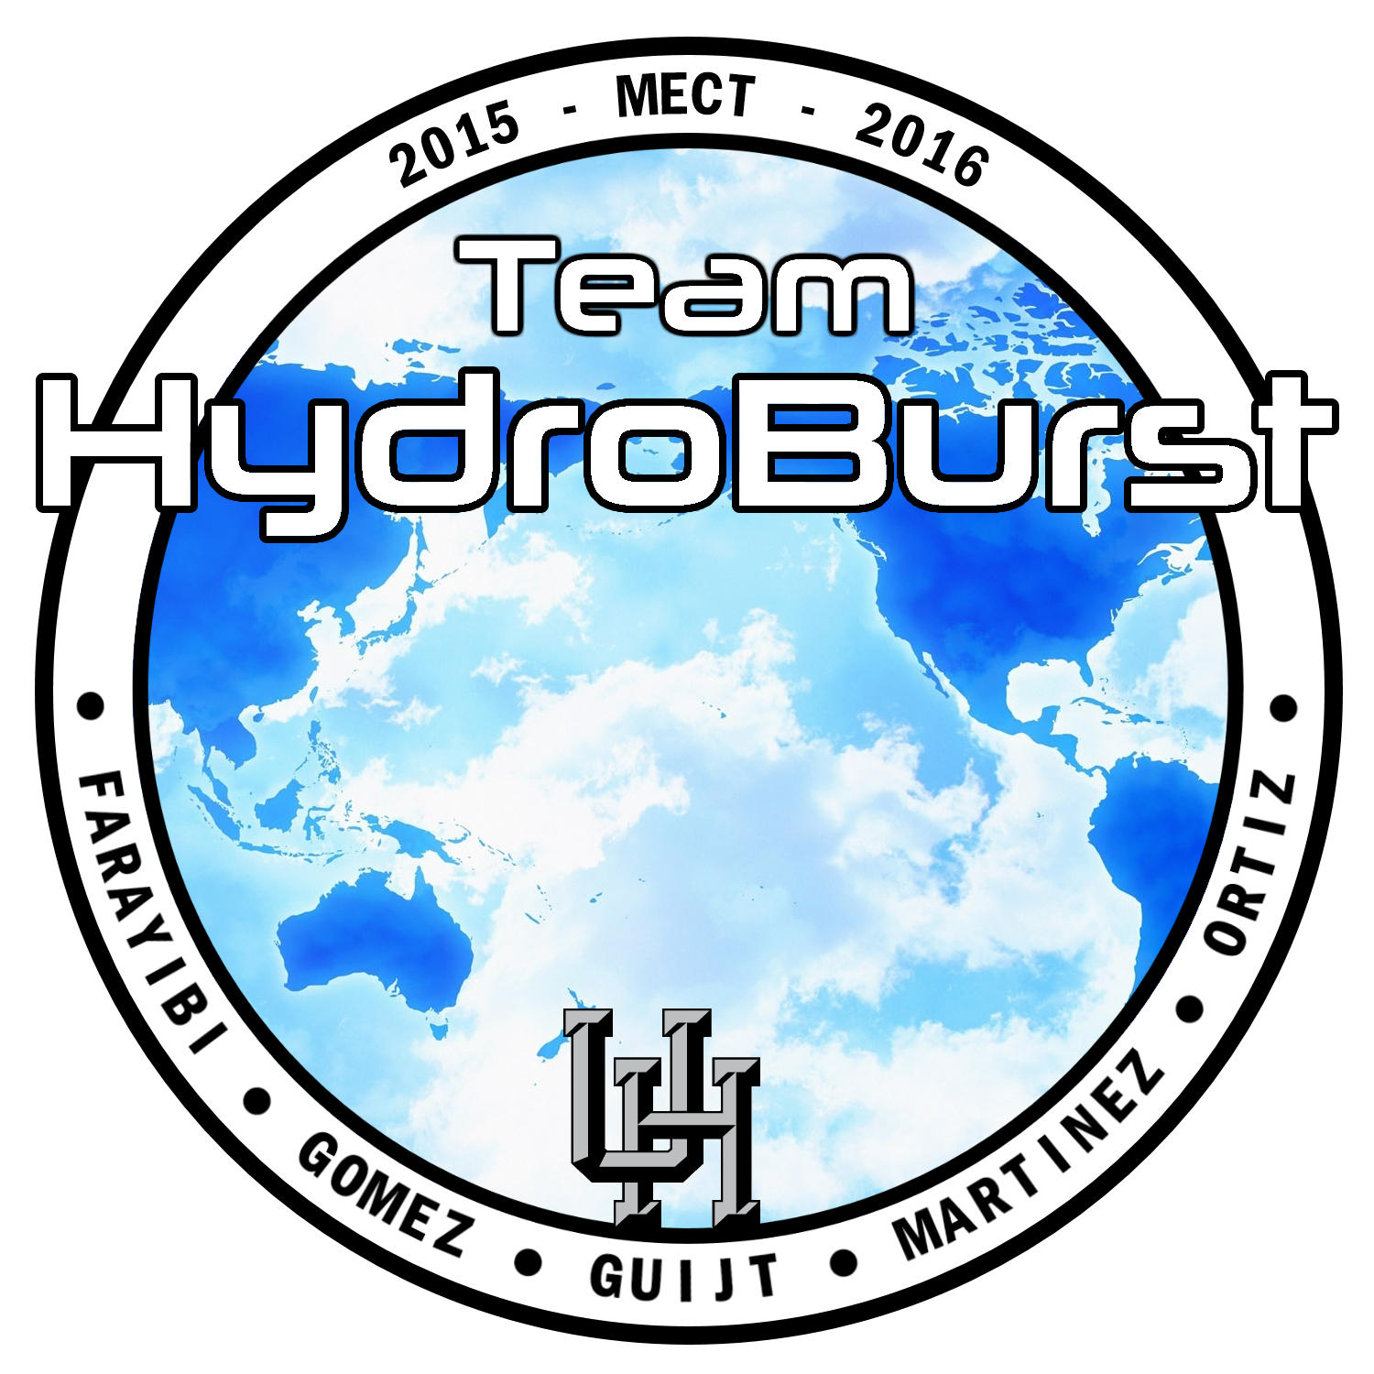
Modular R.O.V for Sub-Sea Operations
Oluyemi Farayibi
Juan Gomez
Gustav Guijt
David Martinez
Victor Ortiz
Introductory Presentation
09/28/2015

Slide 2
ROV Presentation Outline
What is an ROV?
A Brief History of ROVs
The Problem in the Industry
Project Goals
The MATE Competition
ROV Systems
Basic Frame Designs
Design Comparison and Selection Criteria
CAD Designs
Project Timeline
Estimated Expenditures
Goals for the next presentation
Questions/Comments

Slide 3
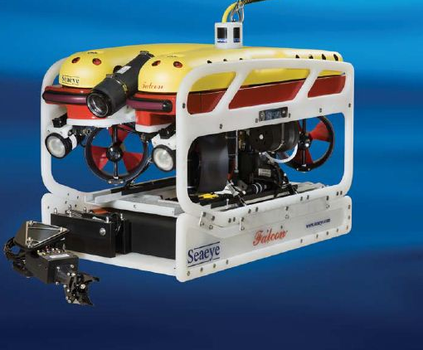
What is an ROV?
[R] – Remotely
[O] – Operated
[V] – Vehicle
Used in:
National Defense.
Resource Extraction.
Science.
Telecommunications.
Search and Recovery.
Construction, Inspection, and Maintenance.
Archaeology
Recreation and Entertainment.
Education.
Notes:
ROV’s allow their operators to pilot them from a relatively safe, dry, and comfortable place, usually on a ship or platform located at the surface of the water above the ROV.
The pilot directs the ROV to perform its underwater work, usually communicating with the vehicle by means of a cable (called a tether or umbilical). This all-important tether also transmit electrical power to the robot and allows data, including audio, video, still images, navigational information, and other sensor readings to be sent back to the pilot.

Slide 4
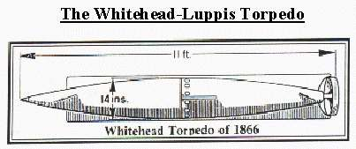
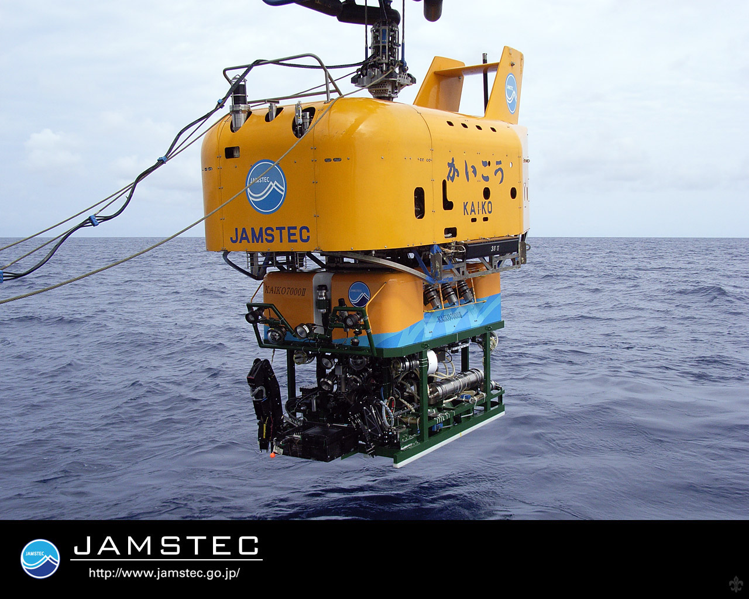
A Brief History of ROVs
Existed in one form or another since 1860s.
In 1953 the first tethered ROV was developed.
During the 1960s the Navy funded advances in the Remotely Operated Vehicles.
During the 1970s and 1980s, commercial firms started utilizing ROVs in subsea drilling operations.
ROVs now operate at 10,000 feet to support drilling.
Record depth of almost 35,791 feet reached by the Japanese Kaiko Ultra-Deep ROV in 1995
Notes:
ROVs have existed in one form or another since the 1860s. With the first one being acknowledged as the PUV developed by Luppis-Whitehead Automobile in Austria during the mid 1860s, but it was not until the 1960s, when U.S. Navy looked at ROV technology for recovering underwater ordinance that the technology advanced to an operational state.
During the 1970’s and 80’s, commercial firms saw a saw a future in ROV support in offshore drilling and oil fields, and funded advancements in the technology.
Today ROVs perform numerous tasks in many fields, including inspection of subsea structures, pipelines and platforms, construction, and repair work. With ROVs working at depths up to 10,000 feet to support offshore oil rigs, and a record depth of about 35,791 feet (10,909 meters)

Slide 5
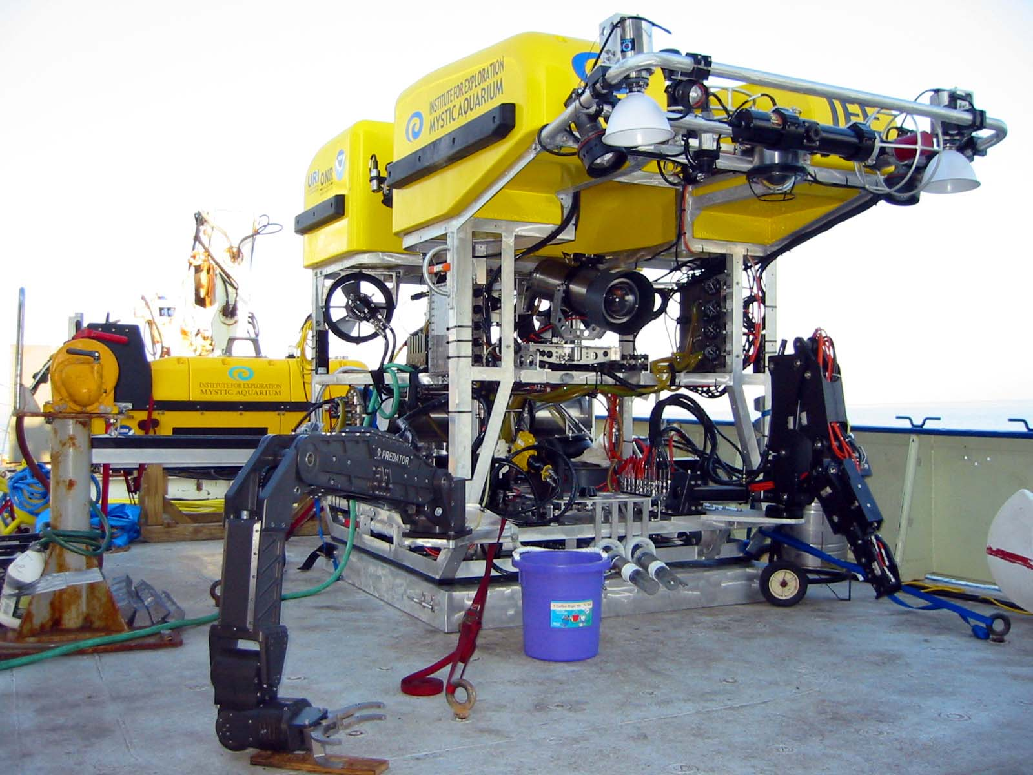
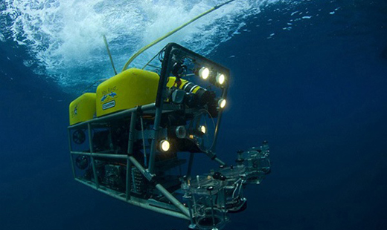
The Problem in the Industry
ROVs can be Bulky to fit all the sensors and devices.
Larger and heavier designs require stronger motors to overcome the weight and drag, leading to less maneuverability.
Notes:
Remotely Operated Vehicles are often large and bulky to fit all the sensors and devices that might be needed to accomplish its job. Meaning space is used up by devices that might not be needed to complete missions.
These larger and heavier designs make it difficult to maneuver the R.O.V, and require stronger motors and more power to be successful.
There is a need for a new type of ROV, that can be set-up for specific missions and jobs

Slide 6
Project Goals
Primary Goals
Secondary Goals
To design, optimize and build an ROV with a modular design
Design of an ROV universal base
To install and program a microcontroller and various sub-microcontrollers
To design and implement motors, sensors and “plug-and-play” ports
To participate in the MATE Underwater Robotics Competition
Design of new components
Control arms with different applications
Laser sensors
Variable ballast to control Buoyancy
To enter the international MATE Competition

Slide 7

2016 Mate ROV Competition
MATE Center was founded as a National Science Foundation Advance Technological Education since 1997.
Teach STEM and prepare students for technical careers.
Competition Classes:
Scout- Beginner
Navigator- Intermediate
Ranger- Moderate
Explorer- Advance
Notes:
SCOUT:
*Elementary schools with robotic experience
*Middle Schools
*High Schools new to robotics
NAVIGATOR:
*Elementary schools with robotics experience
*Middle schools with robotics experience
*High schools new to robotics
RANGER:
*Middle schools with robotics experience
*High schools
*Community colleges and universities new to robotics
EXPLORER:
*High schools with MATE competition experience
*Community colleges and universities

Slide 8
ROV Systems
Frame
Control Systems
Micro-controller, Camera, Lights
Propulsion Systems
Buoyancy (Ballast vs. Foam)
Deployment
How to get in and out of water.
Tether Management System
Operational Components:
Pressure Transducer
Water-Current Flow Meter
Control Arm

Slide 9
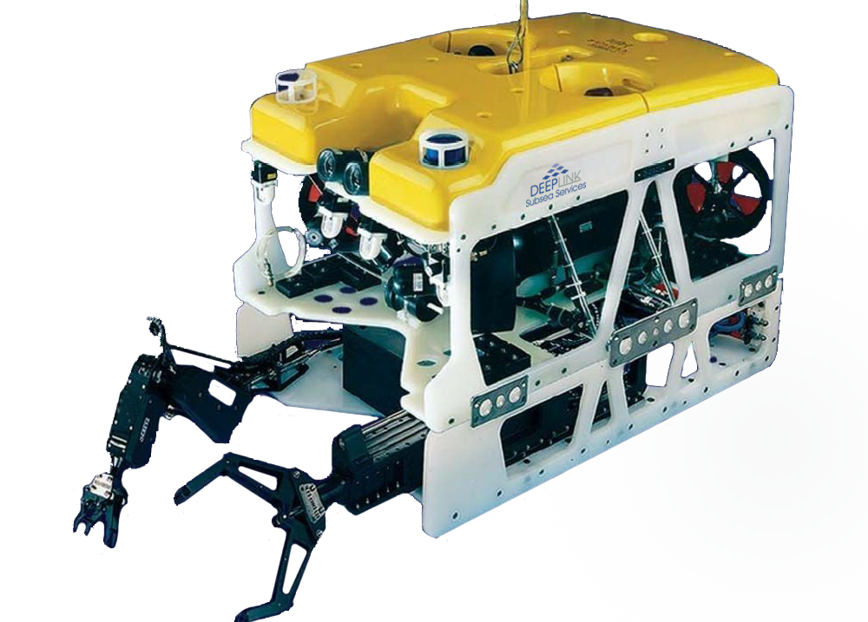
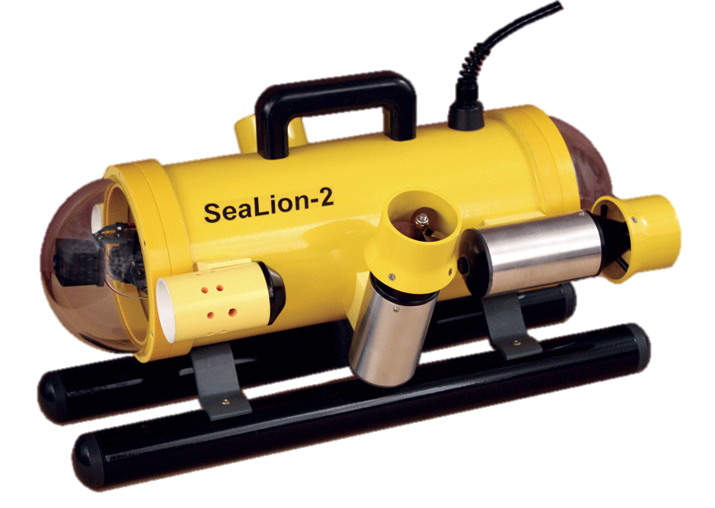
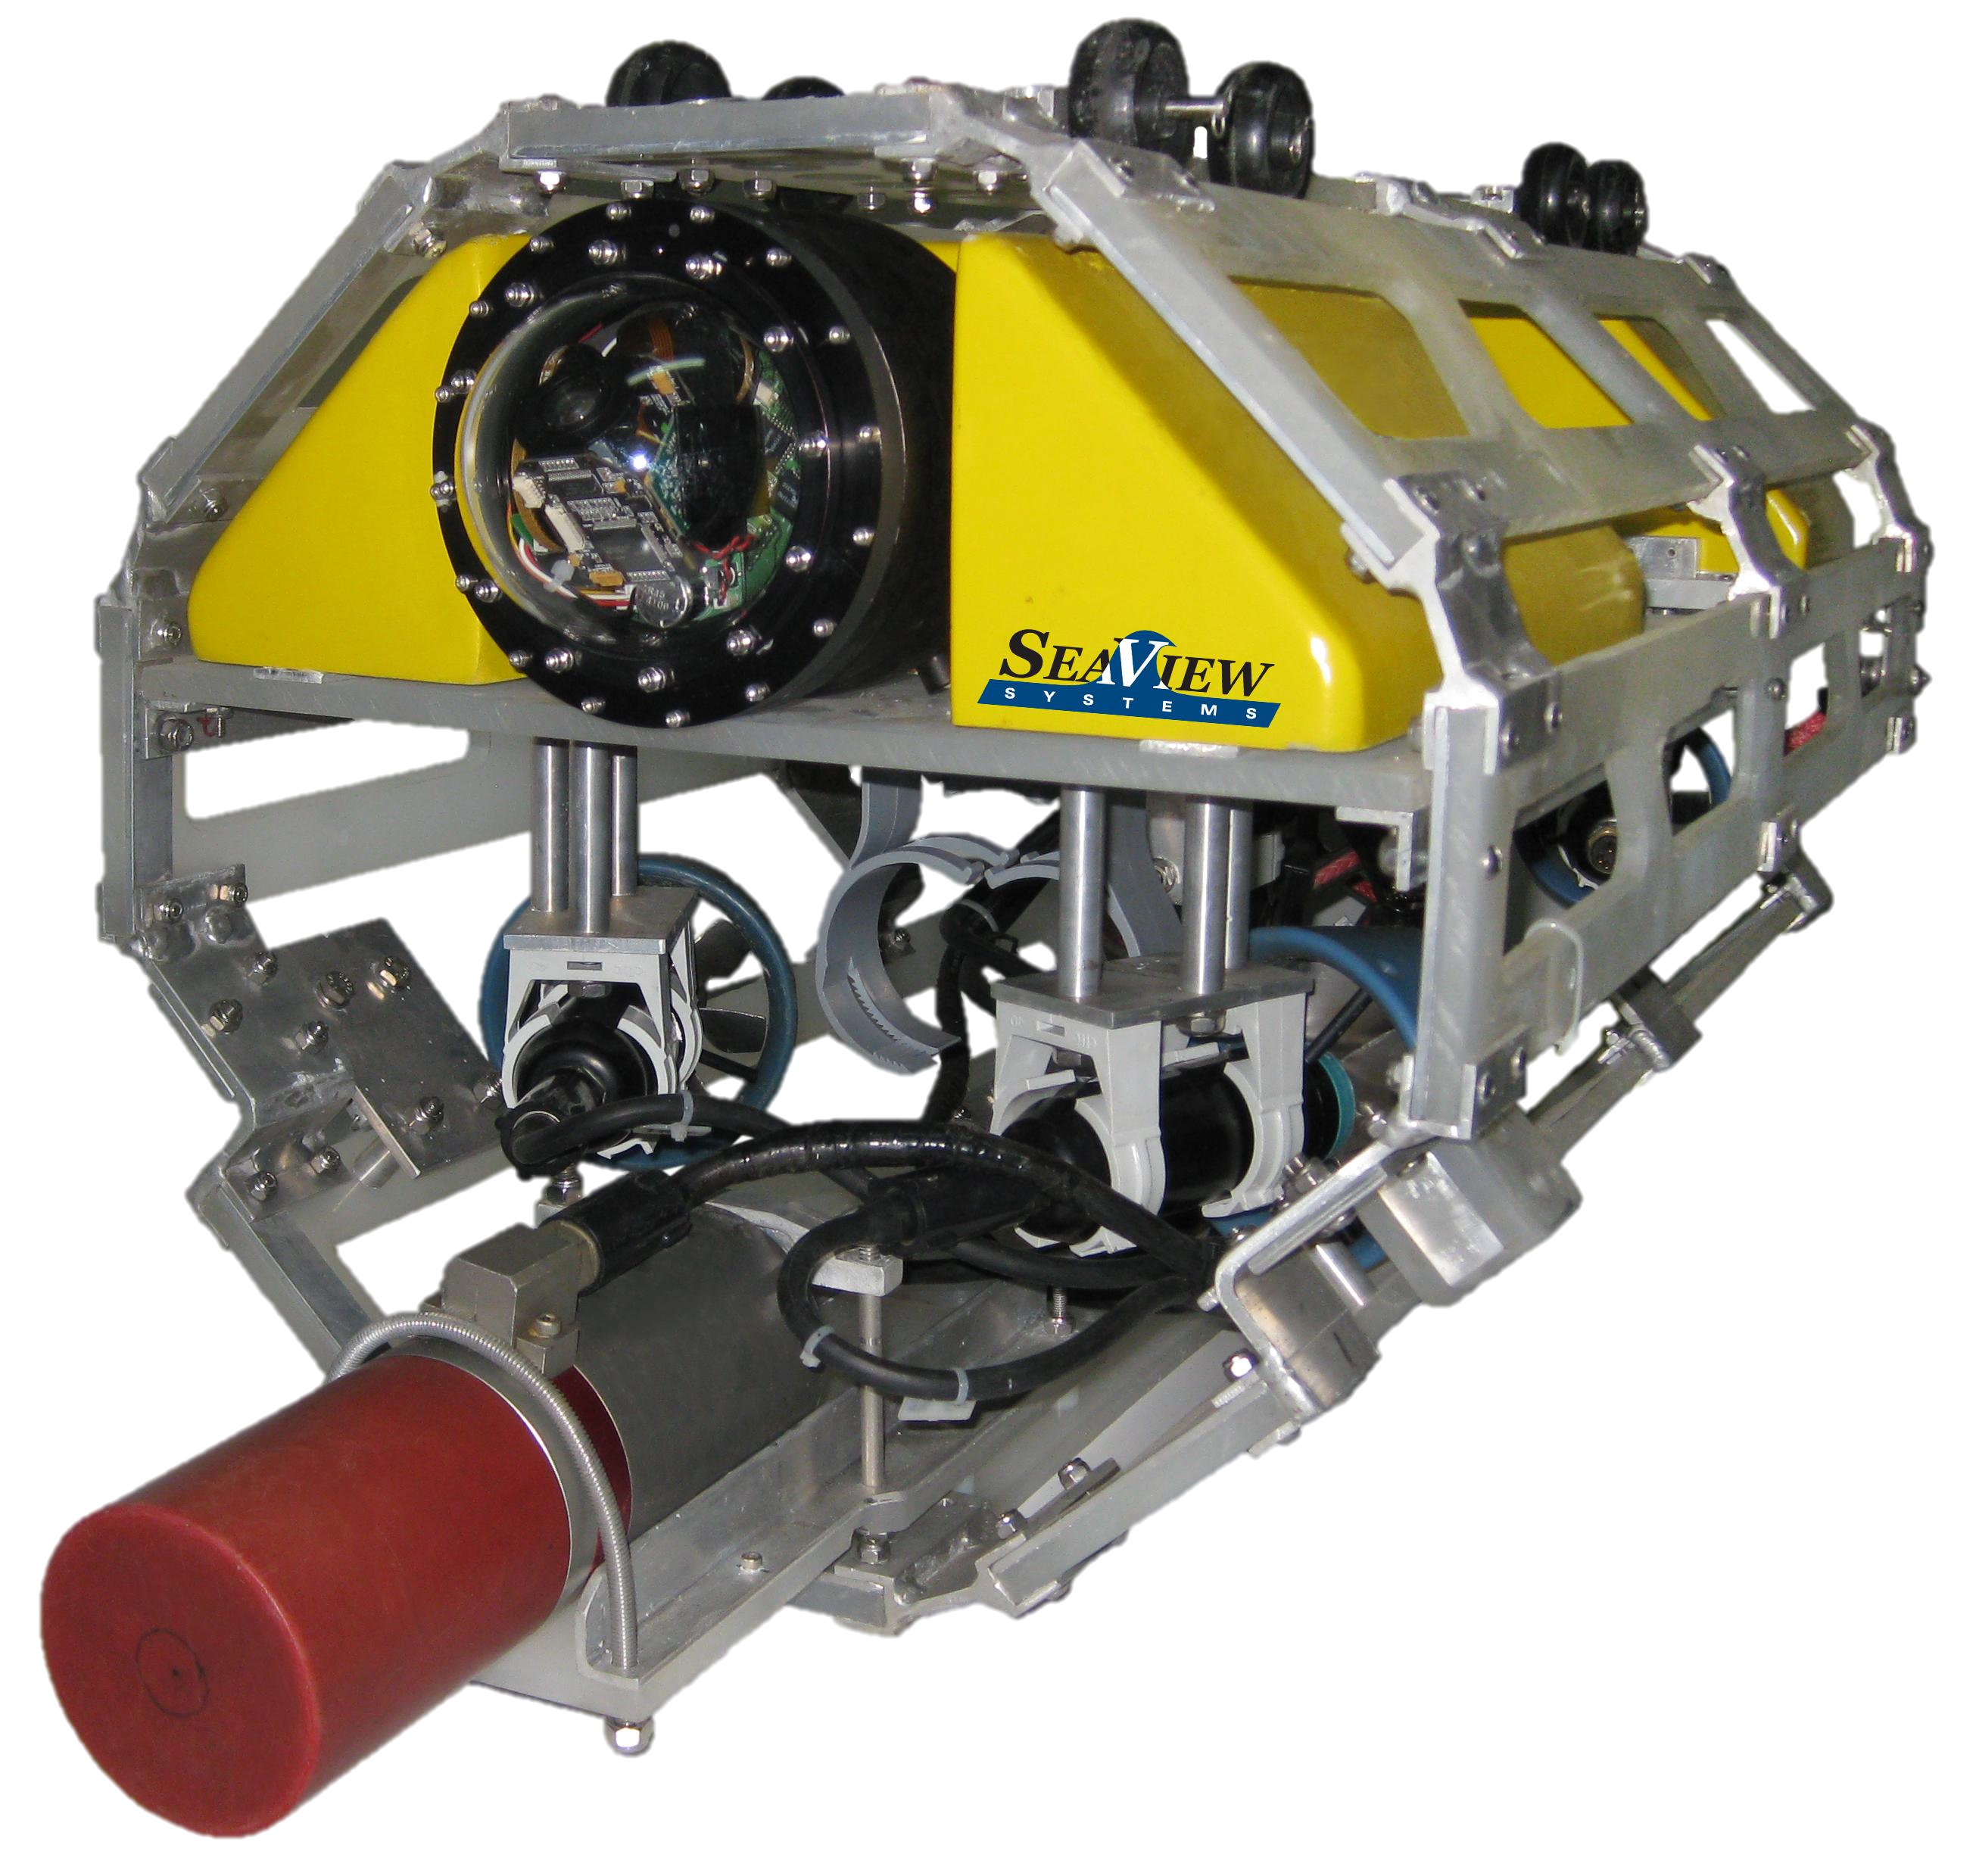
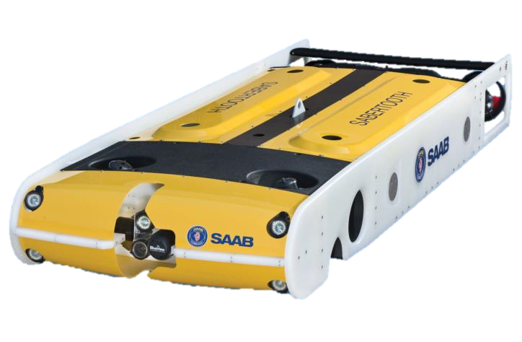
Basic Frame Types
Rectangular Prism
Pros:
Not affected by waves
Allows good deflection of water*
Hollow design
Ease of access of parts
Cons:
Requires power to steer
Takes up unneeded space
Cylindrical
Pros:
Compact ability increases maneuverability
Requires less power to steer
No unneeded space
Cons:
Waves affect stability
Does not allow good deflection of parts
Does not allow ease of access of parts
Solid design increases drag
Pros:
Not affected by waves
Hollow design
Ease of access of parts
Cons:
Requires power to steer
Does not allow good deflection of water
Takes up unneeded space
Pros:
Compact ability increases maneuverability
Requires less power to steer
Allows good deflection of water
Cons:
Waves affect stability
Does not allow ease of access of parts
Solid design increases drag
Octagonal
Flat

Slide 10
Design Comparison and Selection Criteria
 | Maneuverability | Hydro-dynamics | Internal Space Utilization | Modular Optimization | Corrosion Resistance | Totals
Rectangular | 1 | 1 | 2 | 3 | 5 | 12
Cylindrical | 3 | 4 | 3 | 1 | 5 | 16
Octagonal | 4 | 3 | 2 | 3 | 5 | 17
Flat | 2 | 3 | 3 | 2 | 5 | 16

Slide 11
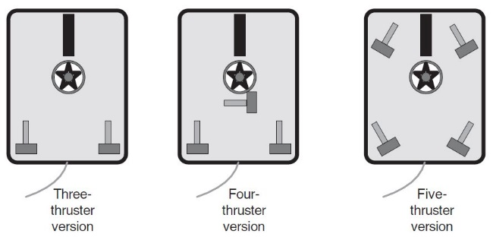
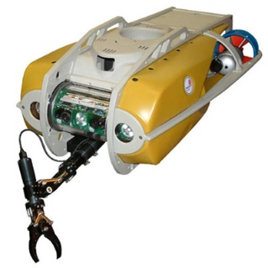
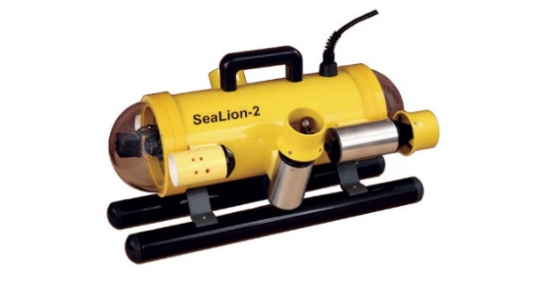
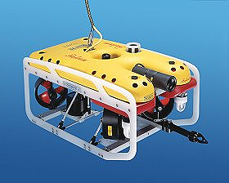
Thruster Arrangement
Three Thruster ROV Four Thruster ROV Five Thruster ROV
Cheapest
Bad Maneuverability
Max 2 degree freedom
Moderate Cost
Moderate Maneuverability
Max 3 degrees of freedom
Needs powerful horizontal motor
Expensive Cost
Best Maneuverability
Max 4 degrees of freedom
Extra Maneuverability

Slide 12
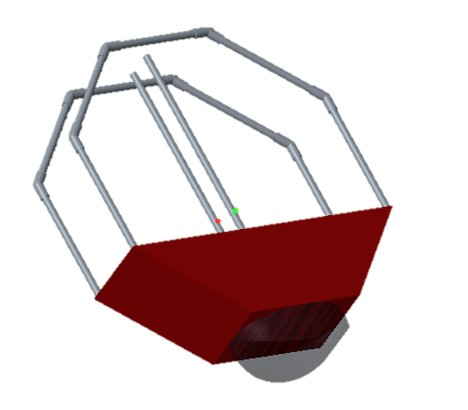
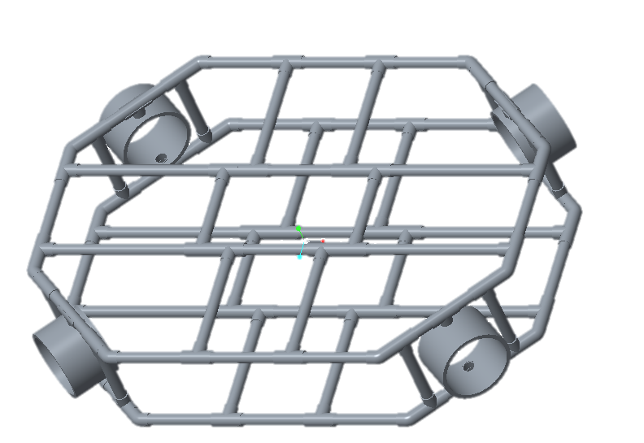
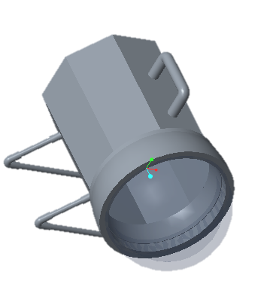
CAD Designs

Slide 13
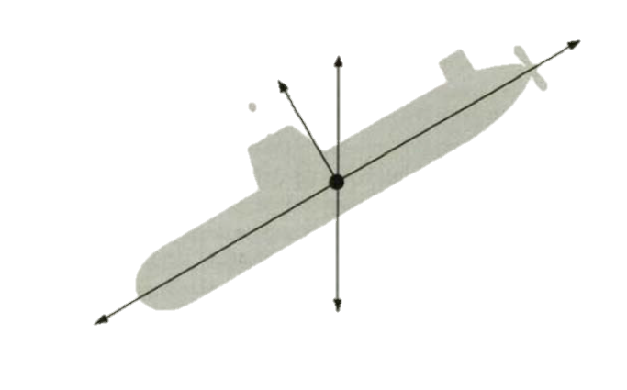
Force Analysis
There are 5 main forces affecting an ROV:
Buoyancy Drag
Lift
Thrust Weight

Slide 14
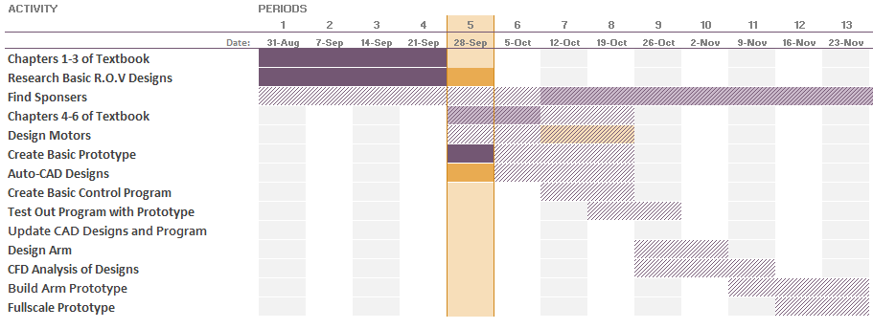
Project Timeline

Slide 15
Estimated Expenditures
Frame → $70 to $300
CPVC (~$70), PVC (~$250), Aluminum (~$150)
Baseboard → $50 to $80
Plastic (~$50), Aluminum (~$80)
Thrusters (Minimum 5, up to 8) → $600 to $2400
Ballast → $100 to $400
Watertight Enclosures → $50 to $200
Controllers and Cables → $200 to $600
Camera/s → $50 to $500
Pressure Sensors → $20 to $200
Arms → $800 to $2820
Total: Estimated Between $1840 and $7500
Price Variation based on a number of criteria (aluminum vs. pvc)

Slide 16
Goals before Next Presentation
Stress and Force Analysis of Designs.
CFD Analysis of Designs.
Search for Sponsors and Adviser.

Slide 17
Thank You for Listening!
Any Questions, Comments, or Concerns?

